Slide 1






Revolutionizing Trading with Artificial Intelligence, Transparency and Community
SIGNAL VASE PITCH DECK
Present by Abdullah Sabir
www.signalvase.com
contact@signalvase.com

Slide 2


TODAY'S AGENDA
1
Introduction
7
Why You Should Choose Signal Vase
2
Problem Statement
8
Specific Goals and Milestones (Signal Vase/EtherealCash)
3
Our Innovative Solutions
9
Funds Needed for Signal Vase in 2025
4
Size of Market
10
OTC Investment Opportunity
5
Revenue Model
11
Meet the Team
6
Direct & Indirect Competitor
12
Thanks For Your Time

Slide 3


INTRODUCTION
Signal Vase is an innovative social media platform and trading signal marketplace powered by AI-driven bot trading systems. It provides traders and investors with intelligent insights while solving real-world issues like scams on platforms such as Telegram and WhatsApp. Signal Vase creates a transparent ecosystem where signal providers share insights, and followers evaluate them through ratings and reviews.
At the core of Signal Vase is EtherealCash, its exclusive cryptocurrency enabling seamless, secure transactions with low fees. With features like AI-powered tools and a dedicated social space for traders, Signal Vase bridges the gap between professionals and enthusiasts, fostering trust, innovation, and growth in the trading community.

Slide 4

Lack of Trust and Transparency on Social Media
Trading signal platforms like WhatsApp groups and Telegram channels are rife with scams and lack transparency.
Financial Risks in Trading Signals
Traders face significant financial losses and limited accountability and can't revenge to signal providers.
Lack of a Social Media Platform for Traders and Investors
Current social media platforms like Facebook, Twitter, and Telegram are not designed only for traders and investors to Post, Share, and monetize.
PROBLEM STATEMENT
AI Bots Lacking Fundamental Analysis
Traditional AI trading bots also lack the ability to perform fundamental analyses, limiting their effectiveness.

Slide 5



OUR INNOVATIVE SOLUTIONS
AI
fundamental analysis AI Trading Bots
Signal Vase’s AI bots integrate technical and fundamental analysis, improving trading decisions by incorporating market news and data
A Transparent Platform
Signal Vase ensures trust with a rating and review system for signal providers, promoting transparency and accountability.
A Social Media Platform for Traders and Investors
Mitigating Financial Risks
Signal Vase is a specialized Social Media platform for traders and investors to post, share, and get monetized. It combines social media features with trading tools.
Signal Vase reduces financial risks by offering verified providers and signal histories and reducing the likelihood of scams.

Slide 6
MARKET SIZE
Projected Market Size
Understanding the projected market size is crucial for Signal Vase's strategic planning. The global online trading platform market is expected to grow from USD 9.55 billion in 2023 to USD 16.71 billion by 2032, exhibiting a CAGR of 6.4%.
Fortune Business Insights
In the cryptocurrency sector, the number of users is anticipated to reach approximately 992.5 million by 2028, with a user penetration rate increasing from 10.76% in 2024 to 12.39% by 2028.
Statista
Focusing on the 20% of traders who rely on social media platforms for trading signals, Signal Vase targets a potential user base of around 198.5 million by 2028. By capturing 5% of this segment, we aim to onboard approximately 9.9 million users, establishing a robust foundation for strategic growth.
These projections underscore the significant opportunities within the expanding online trading and cryptocurrency markets, reinforcing Signal Vase's potential for substantial user acquisition and market penetration by 2028.
Serviceable Obtainable Market: 9.9 M
Serviceable Addressable Market: 198.5 M
Total Addressable Market: 580 M

Slide 7
REVENUE MODEL
AI Bot Licenses
Platform Commissions
Subscription-based AI trading tools.
A percentage from signal provider earnings.
Subscription Fees
Freemium Model
Paid signal access using EtherealCash.
Free basic signals, premium content behind a paywall

Slide 8


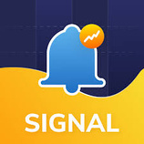


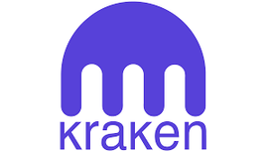

DIRECT COMPETITOR
INDIRECT COMPETITOR
TradingView: Offers charting tools and a social platform for traders to share ideas and strategies.Targets the same customer base and market segments.
ZuluTrade: Provides signal copying and social trading features for forex and crypto.
Telegram & WhatsApp Groups: Unregulated groups offering trading signals.
Binance, Coinbase, and Kraken: Crypto exchanges with limited automated trading features.
MetaTrader 4/5 (MT4/MT5): Popular platforms with support for trading algorithms and signal copying.
Sugnal Vase

Slide 9
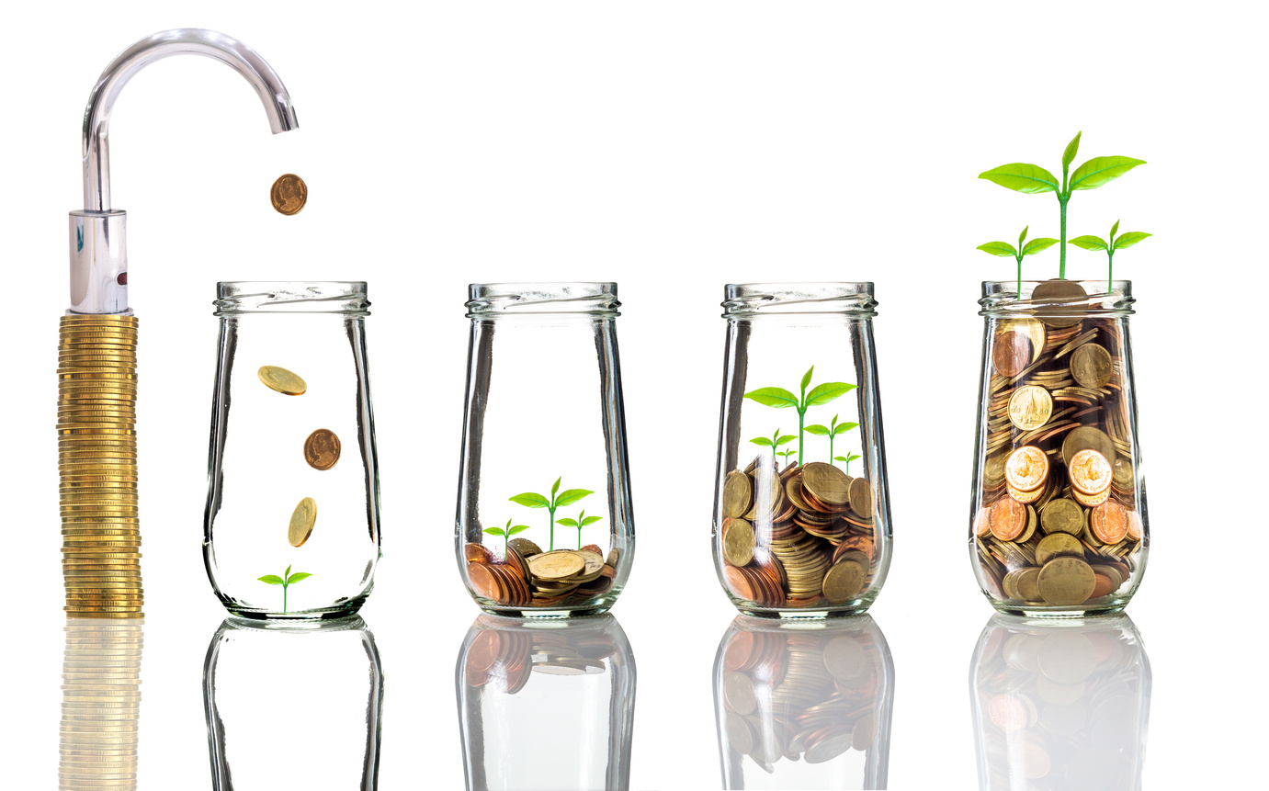


WHY YOU SHOULD CHOOSE SIGNAL VASE
Exceptional ROI Potential
Disruptive and Scalable Business Model
Future Expansion as an AI-Powered Exchange
Signal Vase taps into the expansive trading industry, offering unparalleled opportunities for significant returns on investment.
Our innovative approach addresses real-world trading challenges, providing solutions that are both scalable and impactful.
Long-term scalability with plans to evolve into an AI-powered exchange.

Slide 10
SPECIFIC GOALS AND MILESTONES (SIGNAL VASE)
2025: Foundation and Growth
2026: Scaling and Monetization
In the initial phase, Signal Vase will focus on completing its core features, including the payment and monetization systems powered by EtherealCash. Our priority is to establish a strong foundation by onboarding 100,000 active users and fostering a vibrant trading community through educational campaigns and webinars tailored for signal providers and traders. Strategic partnerships with trading platforms, brokers, and AI firms will accelerate growth, while listing EtherealCash on major cryptocurrency exchanges will enhance adoption and liquidity. These efforts will set the stage for long-term scalability.
With a solid foundation in place, Signal Vase will scale rapidly by introducing its AI-powered exchange. This advanced platform will provide automated trading, portfolio management, and in-depth analytics, creating a comprehensive solution for traders. We will focus on expanding into emerging markets, including South Asia, Africa, and South America, to tap into new user bases. Monetization will take center stage through subscription plans and premium signal offerings, solidifying revenue streams and ensuring sustained growth.

Slide 11
SPECIFIC GOALS AND MILESTONES (SIGNAL VASE)
2027: Market Leadership
2028: Diversification and Dominance
By 2027, Signal Vase aims to establish itself as the market leader in the trading ecosystem. This phase will feature the introduction of cutting-edge AI tools for predictive analysis and risk management, enabling users to stay ahead in volatile markets. Partnerships with institutional investors, hedge funds, and trading firms will position Signal Vase as a trusted platform for professional traders. Simultaneously, we will ensure global regulatory compliance to secure operations across diverse markets and reinforce user trust.
In the final phase of this roadmap, Signal Vase will achieve a global user base of 10 million active traders. The platform will transition into a fully decentralized system leveraging blockchain technology, ensuring transparency and security for all users. Additionally, we will launch AI as a Service (AIaaS), providing our advanced trading tools and APIs to third-party platforms. By 2028, Signal Vase will be IPO or acquisition-ready, marking a major milestone in its journey to becoming the ultimate trading solution for the global market.

Slide 12
SPECIFIC GOALS AND MILESTONES (ETHEREALCASH)
2025: Establishing EtherealCash
2026: Expanding Use Cases
By 2025, EtherealCash will focus on establishing itself as the primary utility token within the Signal Vase ecosystem. During this period, the main goal is to integrate EtherealCash into all platform transactions, including signal purchases, subscriptions, and trading fees. The first step will be ensuring liquidity through listings on decentralized and centralized exchanges. Community building will also be a key priority, with a goal to engage at least 100,000 active users in the Signal Vase ecosystem, helping to drive the demand for EtherealCash.
From 2026, the focus will shift towards scaling EtherealCash’s utility beyond just basic transactions. This includes expanding its use cases to premium trading services, AI-powered exchange features, and portfolio management tools. At the same time, strategic partnerships with cryptocurrency platforms, brokers, and financial institutions will be formed to broaden its market presence. By this stage, EtherealCash aims to see a 500% increase in market volume, demonstrating its growing adoption and utility in the broader trading ecosystem.

Slide 13
SPECIFIC GOALS AND MILESTONES (ETHEREALCASH)
2027: Institutional Adoption
2028: Decentralization & Growth
By 2027, the goal will be to position EtherealCash as a trusted token for institutional investors, with dedicated services for hedge funds and professional traders. Global expansion will be a focus, targeting markets in Asia, Europe, and North America. Listings on major centralized exchanges such as Binance and Kraken will be prioritized to enhance liquidity and increase visibility. With increased adoption and platform growth, EtherealCash will aim for a market cap of $800 million to $1 billion, securing its position as a top-tier utility token in the cryptocurrency market.
Looking towards 2028, EtherealCash will enter a phase of decentralization and long-term growth. The token will transition into a decentralized autonomous organization (DAO), allowing holders to have a say in the future direction of both the token and Signal Vase. Additionally, efforts will be made to achieve broader global adoption, integrating EtherealCash with third-party platforms and financial service providers. By this point, the token will aim to achieve a market cap between $1 billion and $1.5 billion, driven by its deep integration within Signal Vase’s AI-powered exchange and its increasing global user base of over 10 million traders. EtherealCash will be positioned as a widely accepted and highly liquid cryptocurrency, with robust trading across exchanges and in global markets.

Slide 14
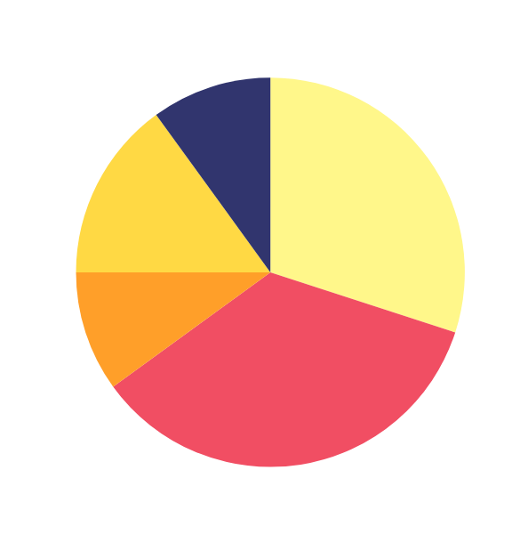
Funds Needed for Signal Vase in 2025
We are seeking a $2.6 million investment to scale Signal Vase in 2025. This funding will help complete critical features, including the EtherealCash payment and monetization systems, while enabling user acquisition through targeted marketing, educational campaigns, and influencer partnerships. Strategic collaborations with trading platforms, brokers, and AI firms will drive growth, and part of the funds will be allocated to listing EtherealCash on major exchanges to boost liquidity. The investment will also support team expansion, compliance, and infrastructure scaling, positioning Signal Vase for long-term success and scalability in the global trading community.
A. 30% Product Development
B. 35% Marketing & User Acquisition
C. 10% Legal & Compliance
D. 15% Operations & Team Building
E. 10% Reserve Fund

Slide 15
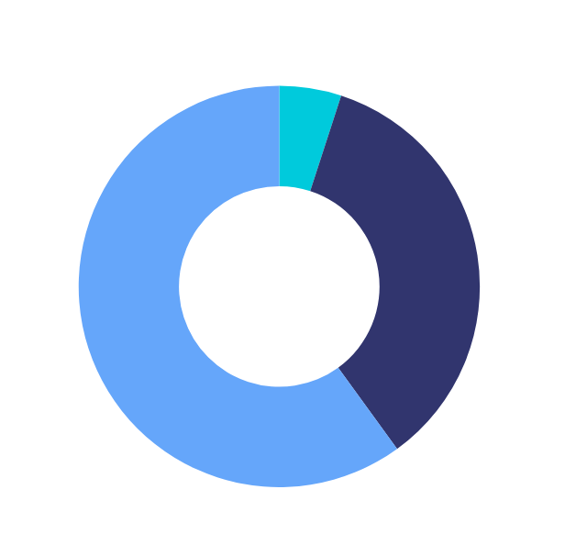
OTC Investment Opportunity
As part of our fundraising strategy, we are offering 5% of the total supply of EtherealCash to OTC investors in exchange for a $3 million investment. This allocation amounts to 25,000,000 EtherealCash tokens, priced at $0.12 per token.
This is a unique opportunity for early investors to gain exposure to a growing platform and benefit from the potential upside as Signal Vase scales and gains market traction in the coming years.
A. 5% of the total supply will be offered to OTC
B. 35% of total supply for ICO.
C. 60% for strategic initiatives

Slide 16




MEET THE TEAM
Thank you for your time!
ABDULLAH SABIR
MUHAMMEDHANZALA
MUHAMMED MAVIA
MAAZ AHMED
Founder & CEO
CTO (Chief Technology Officer)
Lead of App development
Head of AI Development

Slide 17
Signal Vase
THANK YOU
for your time and attention
Present by Abdullah Sabir
www.signalvase.com
contact@signalvase.com

